Slide 1
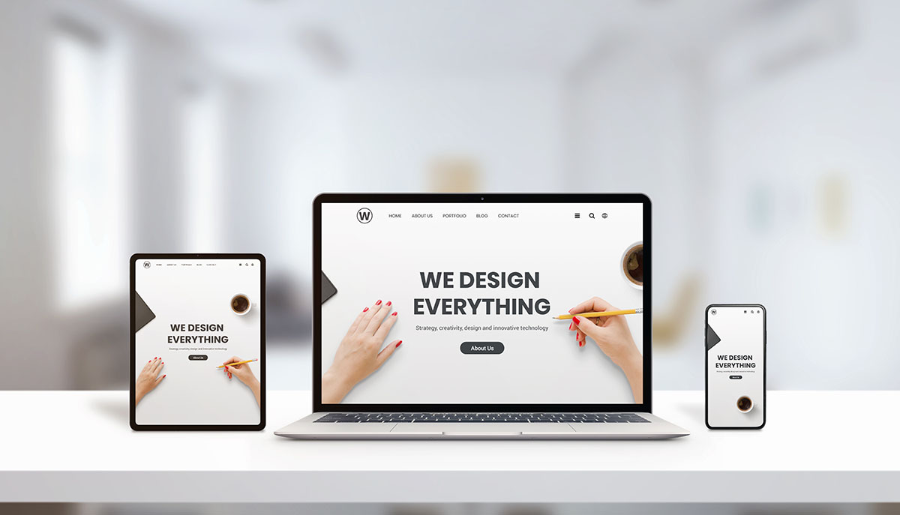
Web Graphic and Prototyping
Web Development Fundamentals GRDN1180 Web Graphics and Prototyping
WELCOME
Introduction
Photo – Adobe Stock
Notes:
Photo of 3 screen sizes responsive design
a good example of how content should scale across screens. Easy to read

Slide 2
Welcome!
Topics we will cover in this course:
Using current industry-standard software for graphics and prototyping, this hands-on course will allow participants to demonstrate the basics of modifying and combining digital photographs and graphics to create realistic composite images for the web.
Participants will practice creating basic website wireframes and mockups as blueprints towards a final web product prototype.
Download the Software: Illustrator, Photoshop, XD

Slide 3
Course Marks
Activity | Grade
Assignments (7 x 3%) | 21%
Quizzes (2 x 8%) | 16%
Projects | 8%
Final Project Presentation - Individual | 20%
Final Practical Exam | 25%
Professionalism | 10%
Total | 100%

Slide 4
Key Dates
For all assignment dates please see the
Instructional Plan (IP) Content>Course Information>Instructional Plan

Slide 5
Reading Resources
There is no textbook for this course
That why it’s important to read the following each week:
Pre-Readings are for your studying
In addition to viewing the slides

Slide 6
Learning Outcomes
Gain expert knowledge by creating compelling scalable graphics and visual content to engage the user flow. Content such as graphics, images, type forms are one of the key components of web design.
Learn the importance and creation process of web graphics and images that are used to draw the user eye to lead them in the right direction as they journey to explore the web/app.
The importance of basic principles of design and elements are key to creating consistent web graphics and web design and this knowledge will enrich your skillset.

Slide 7
Let’s get started!
Let’s get started:
We will take a tour of eConestoga (LMS) together, and take a look at work expectations.
Make sure you have the software ready to go Download the Software: Illustrator, Photoshop, XD

Slide 8

Design Fundamentals
REFERENCE

Slide 9
Module 1
Upon completion of this entire module, you will be able to: Describe the purpose, value, and procedures involved in the creation of wireframe mock-ups and visual content for website development.
1.0 Introduction to Graphics in Web Design – begins
1.1 Describe the purpose and value of graphics design in web development.
We will only cover this one topic this week We will dig into more next week…

Slide 10
Activities Today
Exploring the software
No in-class Task (ICT) this week.
Today, we will begin to look at each of the software applications, the purpose and tools and why designers use Illustrator, Photoshop, and XD to create web graphics, visual content, and layouts.
Instructor led tutorials utilizing the software learn panel* or welcome window **
Photoshop (PS)**, Illustrator (AI)*, and (XD)(Adobe EXperience Design) **

Slide 11
Activities Today (cont’d)
Getting to know the application interfaces
With hands-on tutorials in the app itself or with links to video tutorials and practice files. Work with sample files as supplied and get step-by-step guidance right within the workspace. Let’s explore the software now by opening each one of the applications AI, PS, XD
Learning help Illustrator (Interface) Photoshop (Interface) XD Overview (Interface)

Slide 12
All the Unit Outcomes Week 2
Successful completion of the following units will enable the student to:
1.0 Introduction to Graphics in Web Design
1.1 Describe the purpose and value of graphics design in web development.
1.2 Explain the role of the customer or client in the graphic design process.
1.3 Describe the purpose and key features of a wireframe in web development.
1.4 List various graphic design tools used for web design and their purposes.
1.5 Describe best practices in the creation, organization, and communication of graphical web assets and style guides.

